Slide 1
Campus Placement

Slide 2
Objective:
Developing a model for the prediction of getting on-campus placement for students. The machine-learning model will help the students to know if will they be getting on-campus placement based on their academic scores and relevant experience.
Benefits:
Clarity for the students to apply for the companies where their scores match the requirements.
An overview of the student’s academic scores letting them know where they stand among other candidates.

Slide 3

Problem Statement:
The Placement of students is one of the most important objectives of an educational institution. The reputation and yearly admissions of an institution invariably depend on the placements it provides its students with. That is why all the institutions, arduously, strive to strengthen their placement department so as to improve their institution as a whole.
The main goal is to predict whether the student will be recruited in campus placements or not based on the available factors in the dataset.

Slide 4

Solution:
To solve this problem, the data can be trained on one predicting factor and a machine-learning model can be developed for the prediction.
To achieve this, different machine learning algorithms can be trained. The algorithm with the highest accuracy can be used to predict the outcome of the student’s status of being placed in campus recruitment.
Finally, the user interface can be developed and deployed on an EC2 instance of AWS.

Slide 5
Solution:
To build such a user interface the dataset on which the machine learning model is to be trained and developed must be:
Explored
Cleaned
Split into different ratios for training and testing purposes.
Try out different machine learning models.
Train and evaluate the model.
Develop a webpage and use the trained machine learning model on the webpage for the prediction based on the various features available in the dataset.

Slide 6
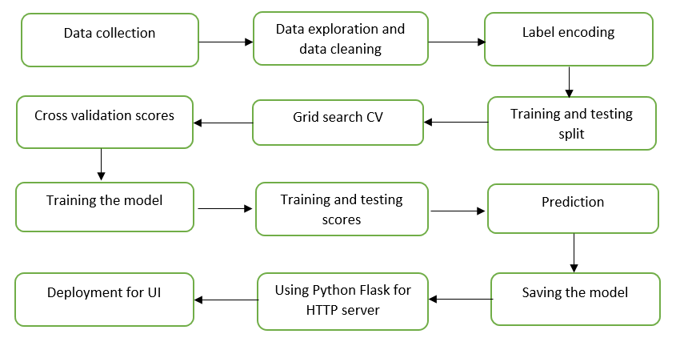
System Architecture

Slide 7
Machine-Learning models:
Different models’ accuracy was evaluated and the one with the highest accuracy was used for the training of the model.
Machine learning algorithms used:
Random forest
Decision tree classifier
Support vector classifier

Slide 8
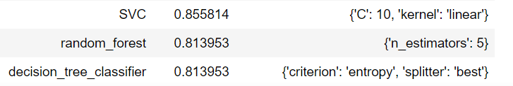
Process of choosing the correct model:
To choose the correct model Grid search cross-validation was used where all the mentioned models were evaluated and some of the parameters were also tuned in an attempt to increase the accuracy.
Support vector classifier before parameter tunning
Support vector classifier after parameter tunning
Support Vector classifier showed the maximum accuracy out of all others and also the accuracy was increased from 84% to 85% tuninging the parameters as seen in the figures above

Slide 9
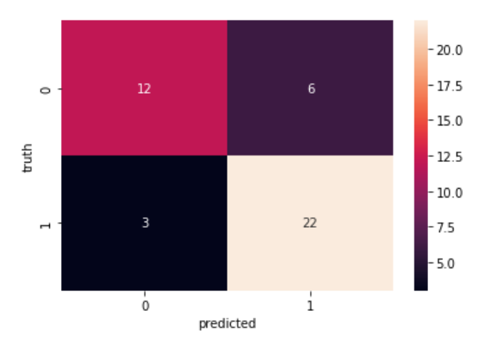
Predictions:
To check the predictions and evaluate the model’s performance the test data visualized on the confusion matrix
This gave an overview of the outcome of the predictions given by the model which showed the same accuracy that is achieved in the test score.

Slide 10

Deployment:
Python FLASK is a web framework that helps to connect the trained machine learning model with the front-end application. A user interfaces wherein this ML model can be used for the prediction with the help of scripting languages can be developed and made available for the user to use its prediction power.
This webpage was then deployed on an Amazon EC2 instance

